Slide 1
Project on: Food Waste Management
Presented By
Supervised By:
Jannatul Ferdaous
Lecturer, Dept. of CSE,
European University of Bangladesh
Name | ID
Saiful Islam Rishad | 190122051
M Sazzad Sultani Roksi | 190122063
Rifatul Islam | 190122041
Tariqul Islam Rifat | 190122050
Most. Sima Akter | 190122015
Thursday 4th April 2022

Slide 2
Outline
Introduction
Motivation
Objectives
Features
Conclusion

Slide 3
Introduction
Food Waste Management is an online software system of donating food to the foodless people around the country.

Slide 4
Related Works
Weather Forecast is an android application which is implemented to provide service in environment & geography sector. In Bangladesh, some of the examples of similar applications of Weather Forecast are: nosh, OLIO, ShareTheMeal: Charity Donate, Foodbank, GoMkt etc.
OLIO
OLIO gives the opportunity to share food and item's preventing waste and saving
money. It serves free stuff, borrow things, and shop homemade directly from
neighbors.
nosh
With the nosh app, you can now track your food inventory, medicines and expiry
date or use by or best before date while you get recipe suggestions on your food
inventory, do shopping planning, and reduce food waste in the household. Nosh
is powered by Artificial Intelligence (AI) which also keeps track of your food
buying and wasting habits to reduce food waste and save money in the process.

Slide 5
Continued…
Foodbank
Food is donated Schools, churches, businesses and individuals donate non
perishable, in-date food to a Foodbank. Food is also collected at 'Supermarket
Collections': These are events held at supermarkets where volunteers give shoppers
a 'Foodbank shopping list' and ask them to buy an extra item or two for local people
in crisis. Food is sorted and stored Volunteers sort food to check that it's in-date and
pack it into boxes ready to be given to people in need.
ShareTheMeal: Charity Donate
ShareTheMeal is the charity app from the World Food Program that allows you to
feed a hungry child with a tap on your phone. As the world faces a record number of
emergencies, the rate of hunger is increasing. The good news is hunger is entirely
solvable. ShareTheMeal is part of the United Nations World Food Program.

Slide 6
Motivation
There are many foodless people around the country. They can hardly afford food for their family and themselves as well. So we took a step to reach food to those helpless people from the wasted food of restaurant, community centers and party centers.

Slide 7
Objective
Doners will post the food detail, pick location address, quantity of people available for donated food
Our agents will buy or take those foods from the pick address and reach to the foodless people

Slide 8

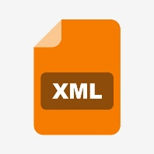


Approach
Platform/Framework | Backend Language | GUI | Database
Native Android with Android Studio | Kotlin | XML | Firebase

Slide 9
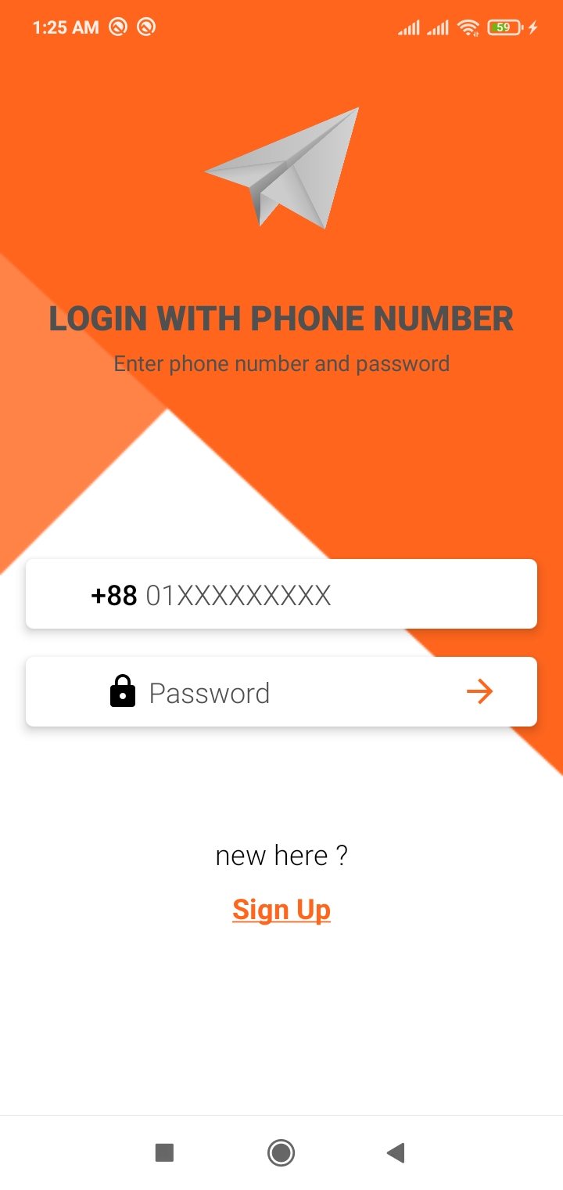
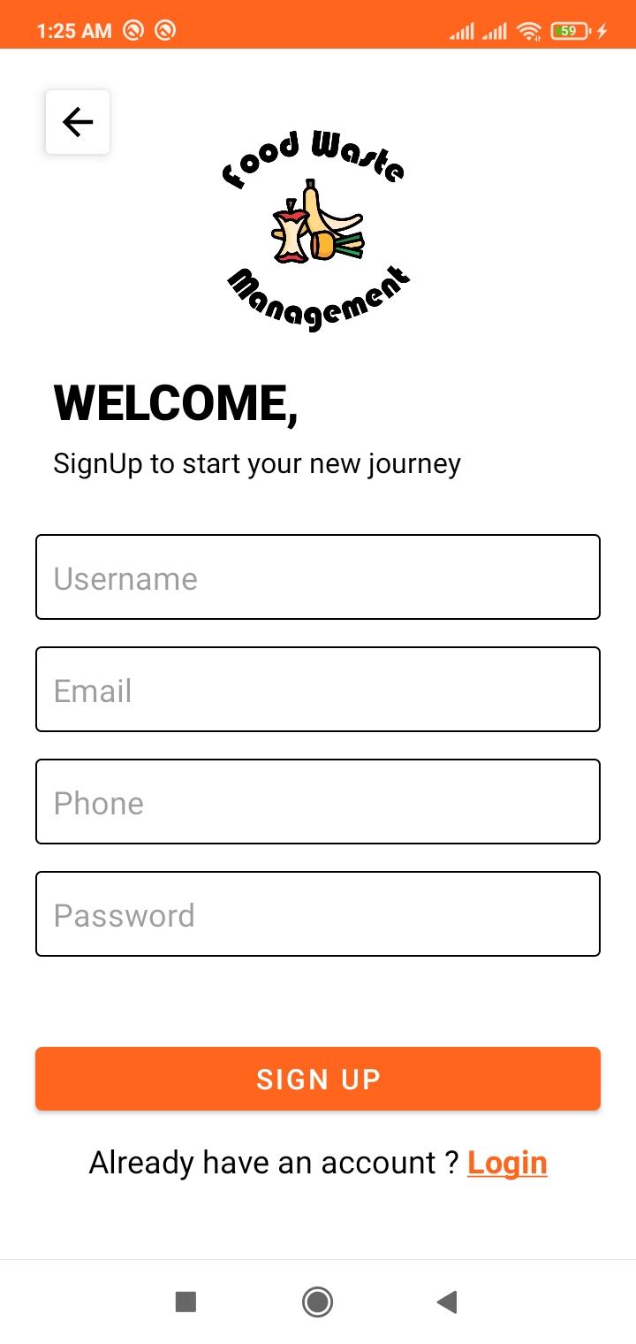
How the proposed system will work (Feature)
Figure: Login
Figure: Signup

Slide 10
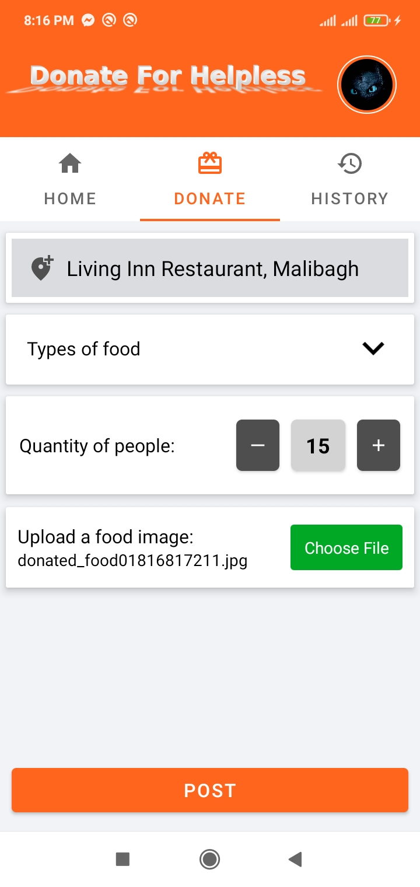
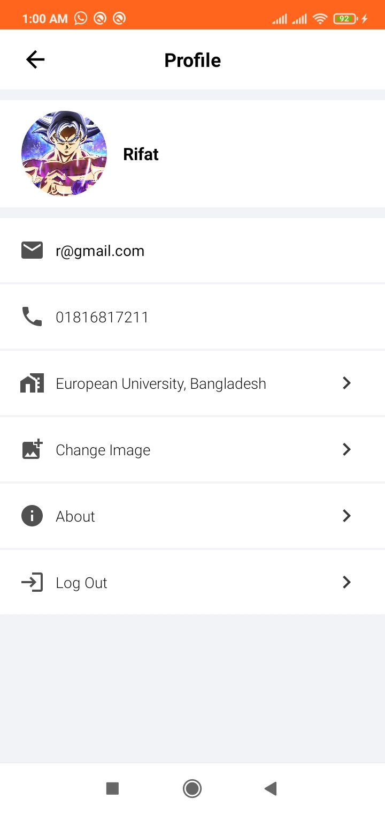
Features (Continued)
Figure: Donate Food
Figure: Profile

Slide 11
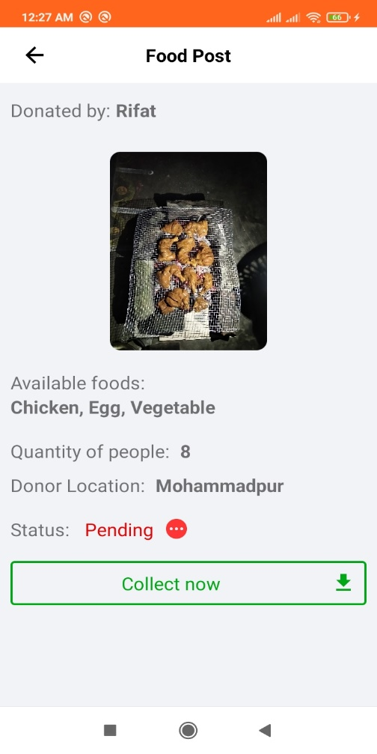
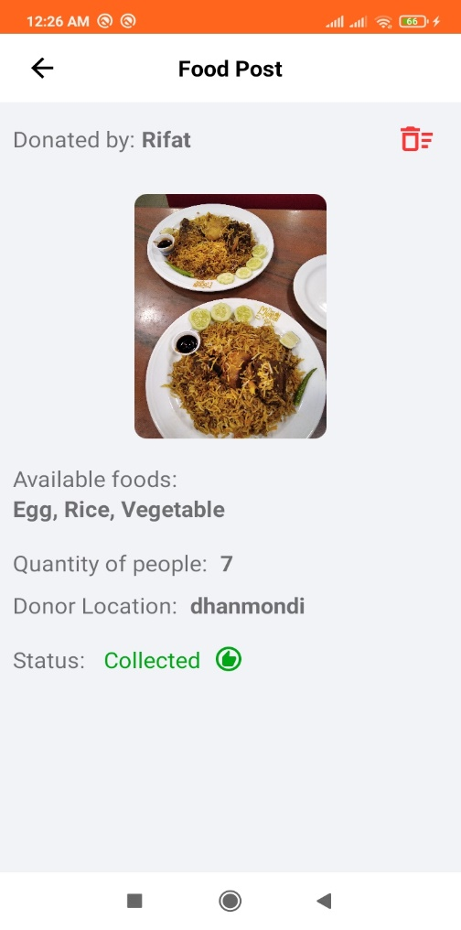
Features (Continued)
Figure: Pending Food Post
Figure: Collected Food

Slide 12
Conclusion
If we want to compete with the world, we have to improve our abilities and contribute to digitalize and improve our society. For this very reason, we chose to develop this project which will help a lot of people.
The objective of this project was to implement approaches to waste management in the foodservice industry with the aim to identify innovations and to discuss their implications for food waste management. A key finding is that many companies are not actively innovating in the waste domain. They are however increasingly aware of the economic and social importance of food waste management. As the study shows, there are only a few low- or zero-waste restaurants. This application consequently provides agents to deliver food to poor, approach to waste issues pertaining to food service firms.

Slide 13
Thank you

